Slide 1

FINAL PRESENTATION
CAPSTONE 749
SECTION 001/003
GROUP 2
Researchers:
Benjamin Mailafiya
Hamizan Arsad
Mankanwar Singh
Sukhmani Kaur
Sukhpreet Singh
12 December 2024

Slide 2
Agenda
Executive summary
Background
Research methodology
Results
Recommendations
References

Slide 3
Business Objective
Envision is focused on studying key variables such as demographics, consumer behavior, lifestyles, and values of modern consumers, particularly those within the millennial and late-stage Gen Z age groups (18–40 years old).
Their primary business objective is to gather and analyze this information to develop a comprehensive dashboard that can provide valuable insights. This dashboard is intended to be sold to their clients, helping businesses better understand and cater to the evolving needs and preferences of new-age consumers.

Slide 4
RESEARCH METHODOLOGY

Slide 5
Mixed method (Exploratory sequential)
By starting with qualitative exploration, the exploratory sequential (mixed) method ensures that subsequent quantitative research is grounded in real-world insights, increasing the relevance and applicability of the findings.

Slide 6
Phase 1
We conducted a qualitative research first to understand and explore the research topic. This was done by conducting literature review and focus group discussion. Transcript was used as main input for analysis.
Phase 2
We followed up with quantitative research on our revised research hypothesis. A survey was conducted and then analysed using statistical tests and verified with machine learning and predictive analytical tools.

Slide 7
Primary Objective:
To understand how different factors of social media influence a person’s decision or intention to travel.
Secondary Objectives:
To explore how social media features (comments, reviews, stories) create emotional connections that inspire travel. (Wang et al., 2022)​(Gai et al., 2024)
To dive deep into how FOMO (Fear of Missing Out) and travel envy, triggered by social media, shape users' decisions to visit new destinations. (Mohanan & Kushe Shekhar, 2021) (Rahjasa et al., 2024)
To get to the heart of how much trust and credibility in online reviews and influencers influence travel choices. (Han & Chen, 2022) (Arica et al., 2022)

Slide 8
Qualitative research
(Phase 1)

Slide 9
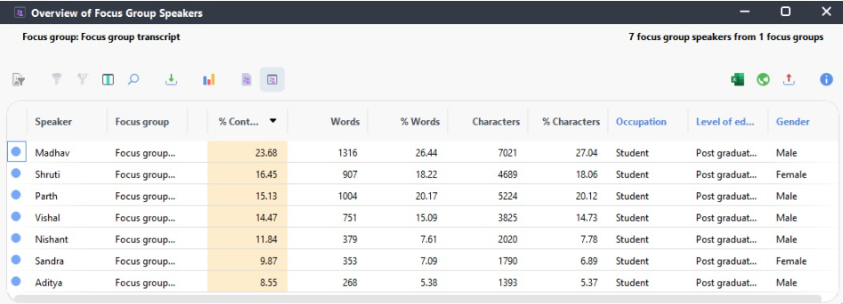
* For Centennial context, sample finally taken from course mates
Sampling criteria
Engagement on social media platforms
Passion for exploring destinations
Age range (Gen Z & millennials)
Focus group details
Classroom E2-16
Recorded session
40min duration

Slide 10
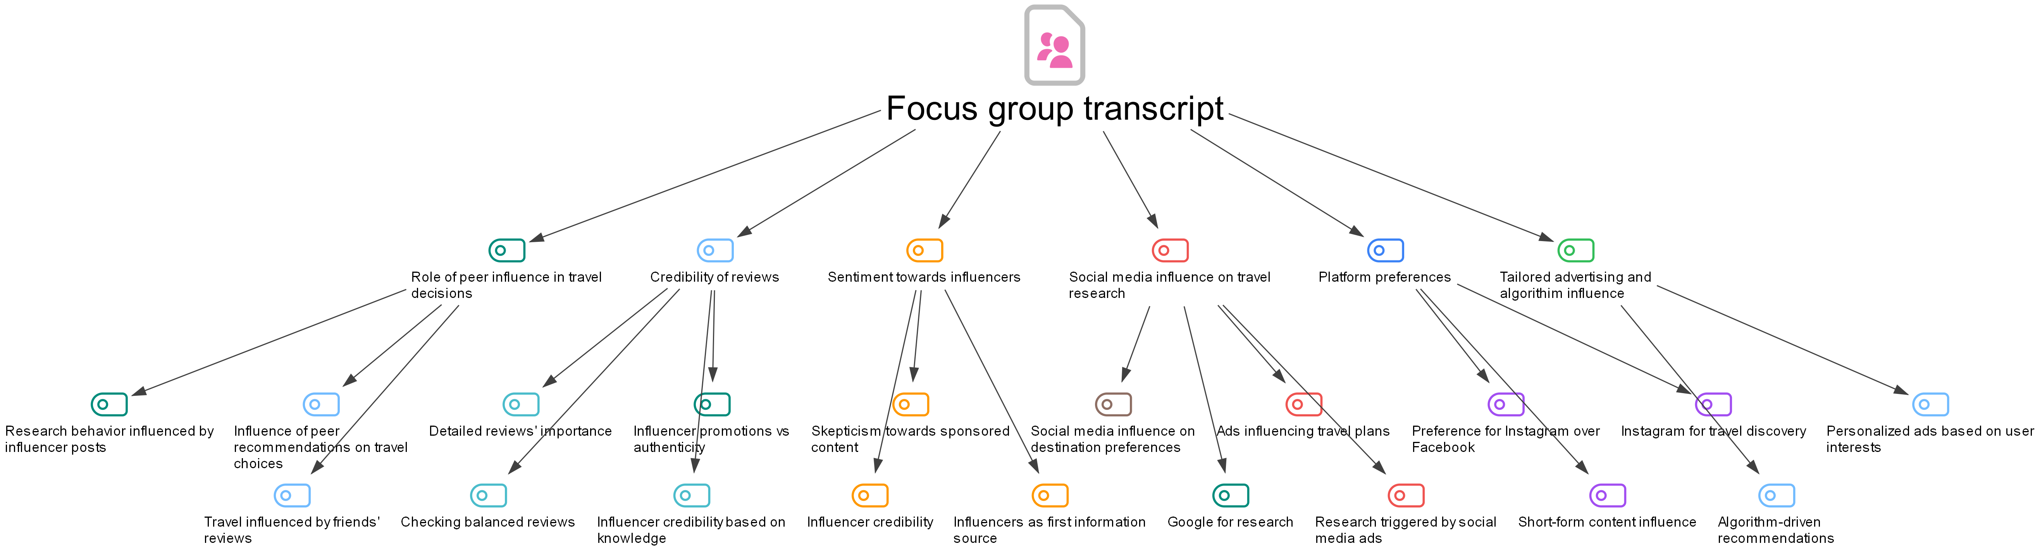
Concept mapping

Slide 11


Qualitative data analysis
MAXQDA was used as the main tool for data analysis. The Questions-Themes-Theories (QTT) feature helped to organize the data, document and integrate insights.

Slide 12
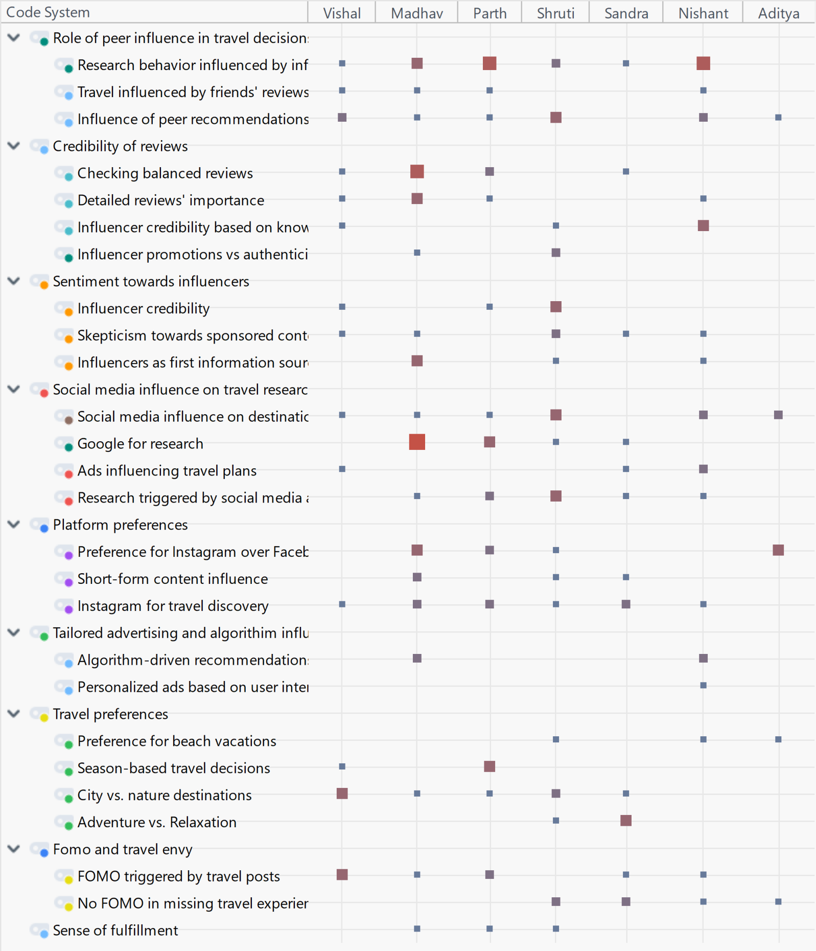
Code matrix
The code matrix feature was used to help map out significant segments. This was helpful in guiding the analysis.

Slide 13
Insights from qualitative analysis:
Social media platforms not only inspire travel, but becomes a tool for researching destinations.
Engaging with features like comments and reviews evoke strong emotions and encourage them to discover new places.
FOMO effects participants strongly, especially when seeing posts from family and friends but is tempered by finances and availability.
Credibility is important for participants. Influencers are often the initial sources of travel inspiration, but participants conduct additional research before making decisions.
Participants prefer authentic, detailed information over purely promotional content.
"Yeah, it is like social media helping me out. It is kind of helping me out to understand my travel preferences because, like, there are many types of like areas or the places which I am not, I'm not aware. So, I don't know whether I should visit or not. So social media can help me identify those areas and like whether I want to visit or whether it is in my interest or not."
"It just comes to my feed, like in Instagram, I used to check the comments or like the description in which, which island or which place it is. So, it will give me an idea about that, and I will research on that."
"When someone is promoting a place or something there should be some evidence regarding if it's good or not."
"Yeah like one day when I get enough money."
* Insights based on opinions of 7 respondents.

Slide 14
Quantitative research
(Phase 2)

Slide 15
Quantitative research design
Purpose: Determine how social media influences travel intentions among Gen Z and millennials
Hypothesis: Guided by insights from Phase 1
Data collection: Survey
Variables: Dependent variables (DV), independent variables (IV), demographic variables
Data analysis: Descriptive statistics, predictive modeling.

Slide 16
Quantitative objectives
Measure the Impact of Social Media Engagement on Travel Intent
Evaluate the Role of FOMO in Influencing Travel Decisions
Analyze the Influence of Credible Influencers on Travel Intent

Slide 17
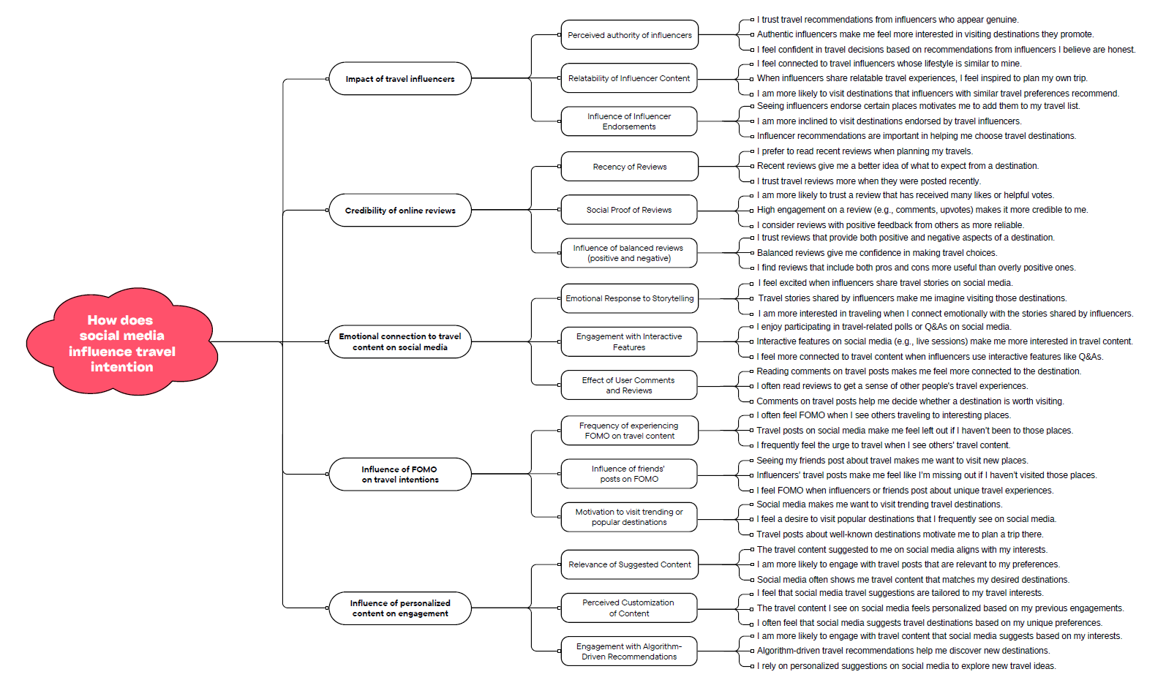

Slide 18
437
Email
invites
20
Surveys
started
10
Surveys
finished
2%
Response
rate
20%
Completion
rate
69
Surveys
finished
Survey sampling
We were given a list of Centennial College students to invite to take the survey via email. However, as the response was low, we expanded our sample size and invited them to take the survey via an anonymous link.

Slide 19
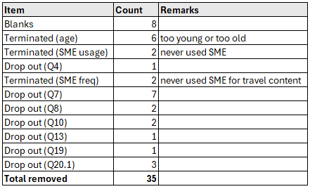
Data cleaning

Slide 20
Exploratory Analysis
Cleaned dataset
Factor analysis
Factor loading matrix

Slide 21
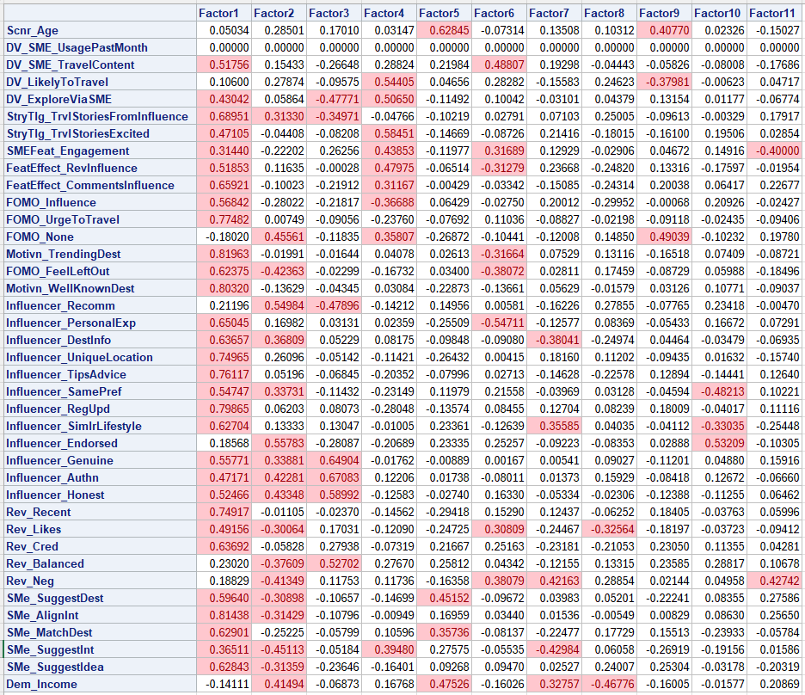
Factor Analysis

Slide 22
Exploratory Analysis
Factor loading matrix
New latent variables

Slide 23
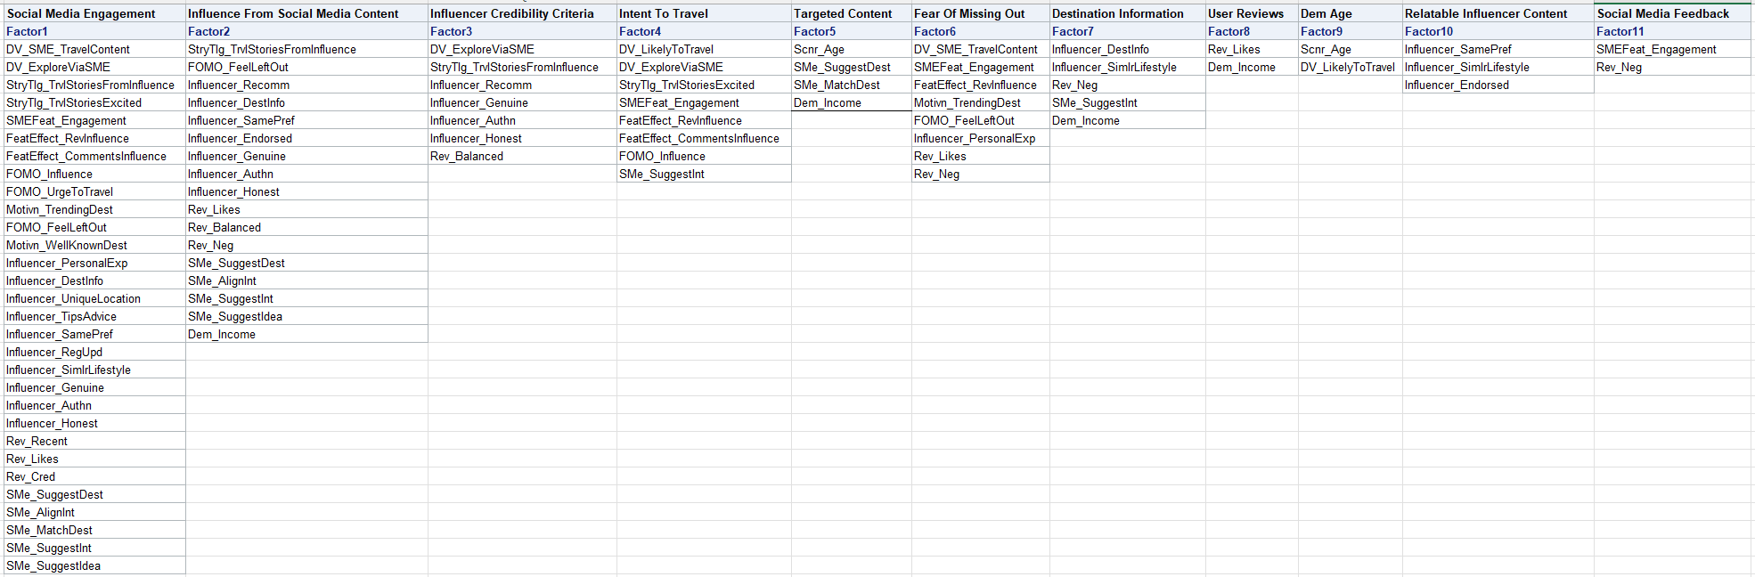
Latent variables

Slide 24
Exploratory Analysis
New latent variables
Composite score
Correlation heatmap

Slide 25
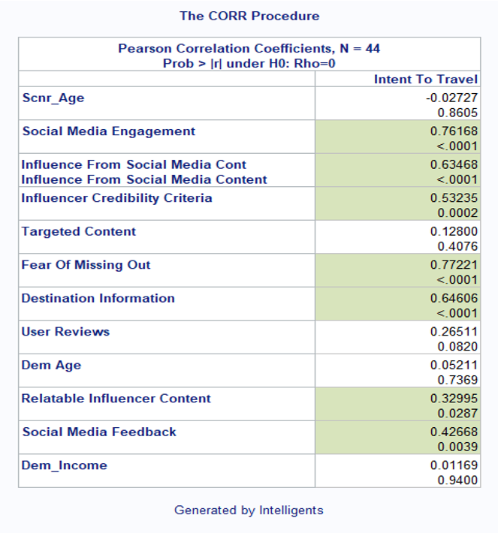
Correlation heatmap

Slide 26
RESULTS

Slide 27
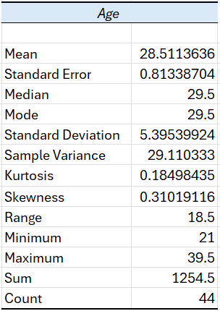
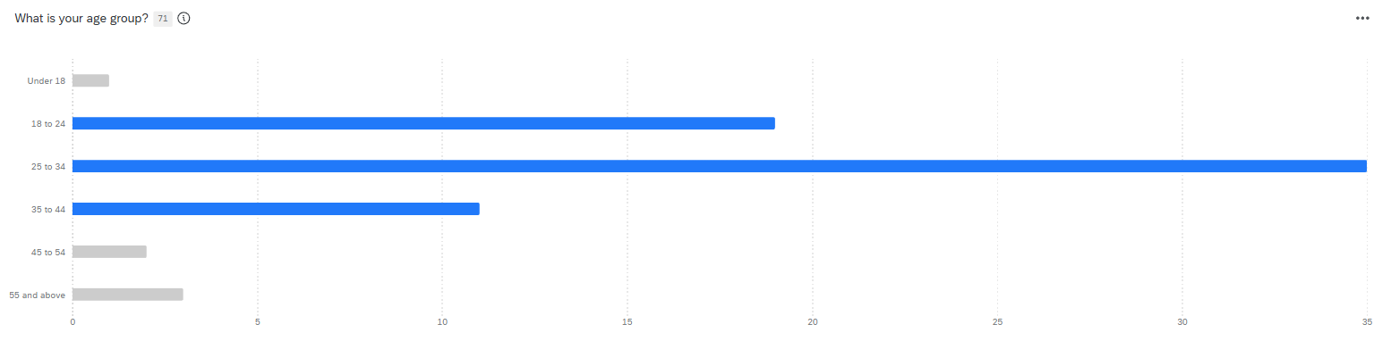
Descriptive analysis
Only responses from ages 18 – 44 were included in the results

Slide 28
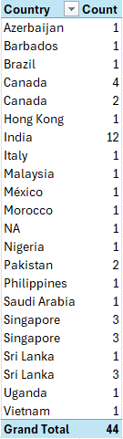
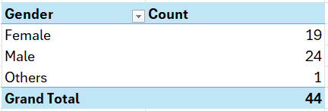
Gender
Origin

Slide 29
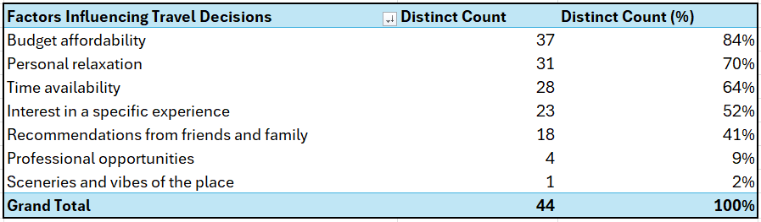
The majority of the respondents cited budget affordability, personal relaxation, and time availability as their top three factors influencing their travel decisions. This is consistent with the insights from the focus group discussions.

Slide 30
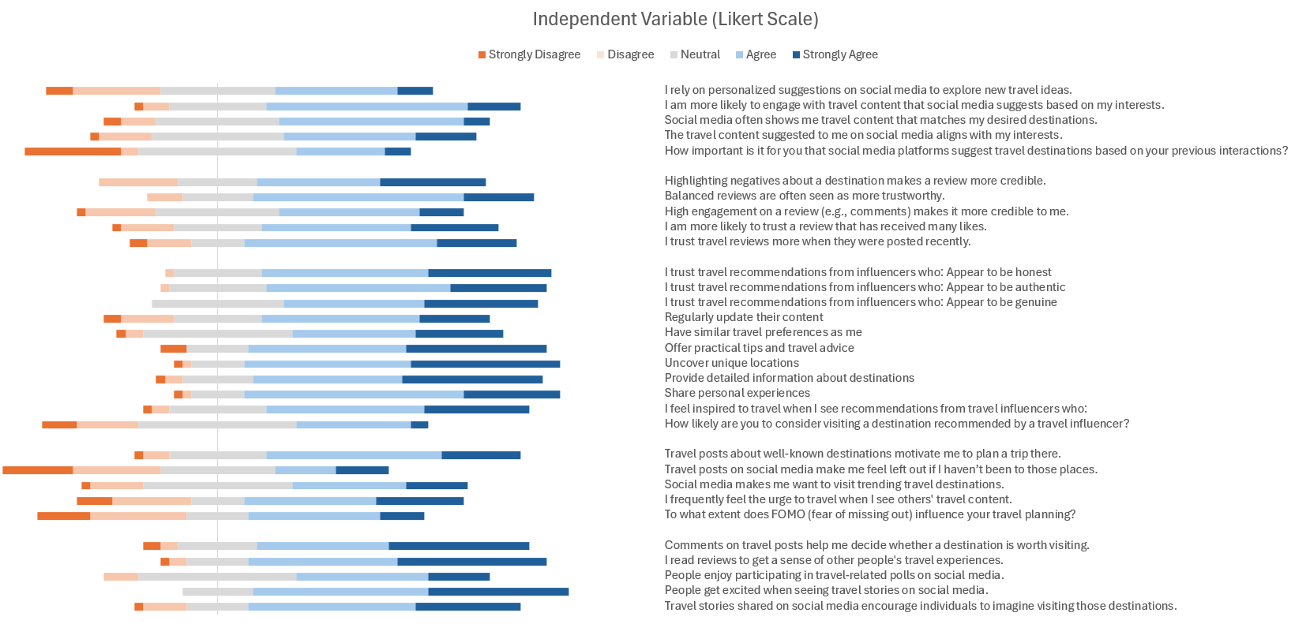

Slide 31
Hypothesis tests

Slide 32
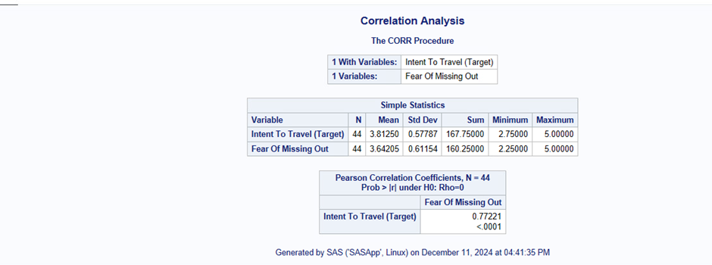
Statistical test with Hypothesis and Conclusion
Hypothesis Testing:
H0 There is no correlation between FOMO and the intent to travel.
H1There is a significant positive correlation between FOMO and the intent to travel.

Slide 33
INSIGHT
The strong positive correlation (r = 0.77) suggests that individuals with higher levels of FOMO are more likely to have a greater intent to travel. This insight highlights the psychological impact of FOMO on travel behaviour, emphasizing its importance as a motivator for travel-related decisions. This could be leveraged in marketing strategies by emphasizing exclusivity and urgency in travel promotions.

Slide 34
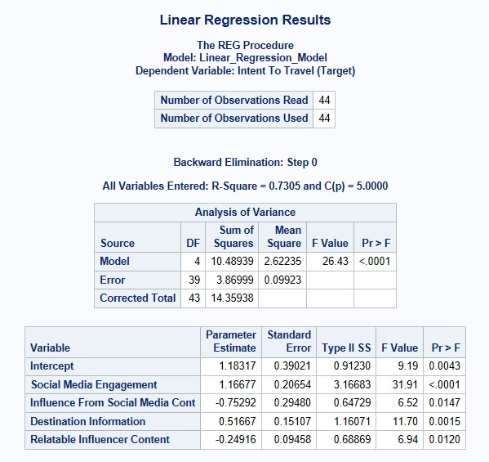
Multiple linear Regression Hypothesis Testing:
H0: None of the selected independent variables like Social Media Engagement, Influence from Social Media Content, Destination Information, Relatable Influencer Content significantly influence the intent to travel.
H1: At least one of the selected independent variables significantly influences the intent to travel.

Slide 35
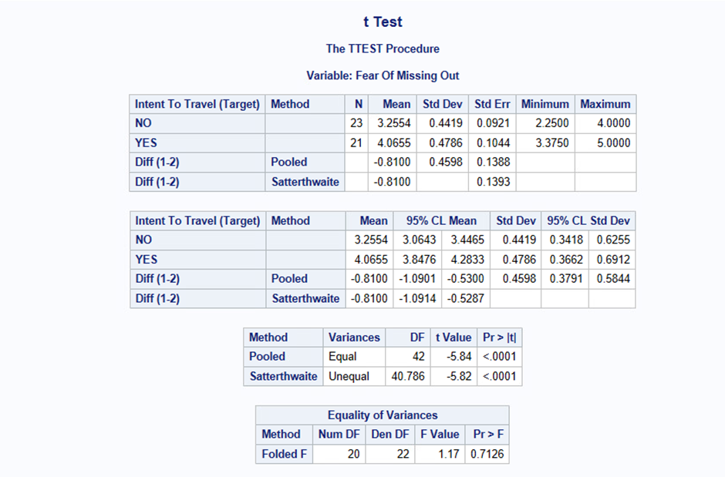
Hypotheses:
Null Hypothesis : Fear of missing out does not significantly affect the intent to travel.
Alternative Hypothesis : Fear of missing out significantly affects the intent to travel.
Insight:
There is a statistically significant difference in "Intent to Travel" between individuals with high and low levels of "Fear of Missing Out (FOMO)." The mean score for "YES"((4.0655) is significantly higher than for "NO" (3.2554), with a mean difference of -0.8100. This indicates that individuals experiencing higher FOMO have a stronger intent to travel.
Decision:
Since the analysis reveals a significant relationship, accept the hypothesis that "Fear of Missing Out" significantly affects "Intent to Travel."

Slide 36
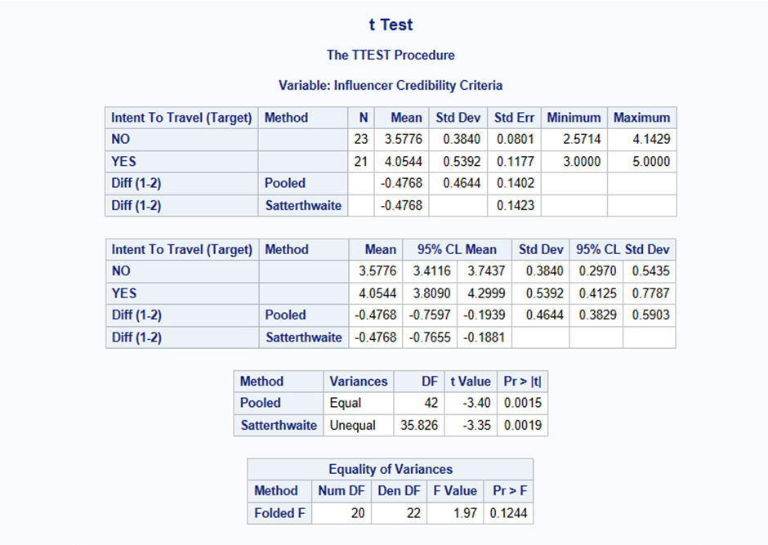
Hypotheses:
H0: Influencer credibility does not significantly affect the intent to travel.
H1: Influencer credibility significantly affects the intent to travel

Slide 37
INSIGHT
There is a statistically significant difference in "Intent to Travel" based on the "Influencer Credibility Criteria." Respondents who perceive influencers as credible (YES) have a significantly higher mean score (4.0544) compared to those who do not (NO 3.5776). The mean difference of -0.4768 is both significant (p < 0.05) and meaningful. This suggests that trust in influencer credibility positively impacts travel intent.
Decision:
Since the analysis reveals a significant relationship, accept the hypothesis that "Influencer Credibility Criteria" significantly affects "Intent to Travel."

Slide 38
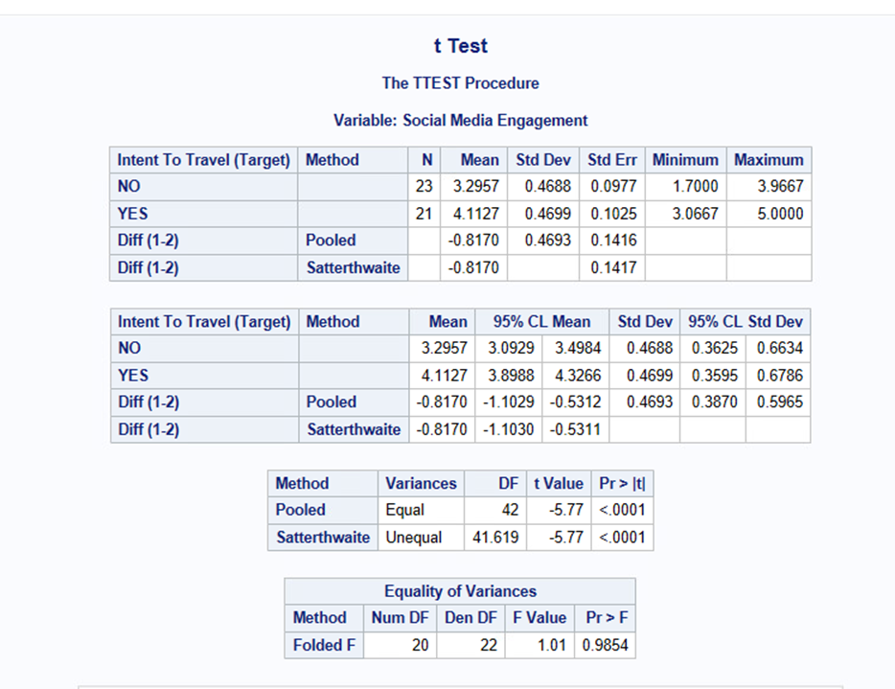
Hypotheses
H0: Social media engagement does not significantly affect the intent to travel.
H1 : Social media engagement significantly affects the intent to travel.

Slide 39
INSIGHT
There is a statistically significant difference in "Intent to Travel" between individuals with high and low levels of "Social Media Engagement." Respondents with higher social media engagement (YES) have a significantly higher mean intent to travel (4.1127) compared to those with lower engagement (NO 3.2957). The mean difference of -0.8170 is both significant (p < 0.0001) and substantial. This suggests that social media engagement plays a critical role in influencing travel intentions.
Decision:
Since the analysis reveals a significant relationship, accept the hypothesis that "Social Media Engagement" significantly affects "Intent to Travel."

Slide 40
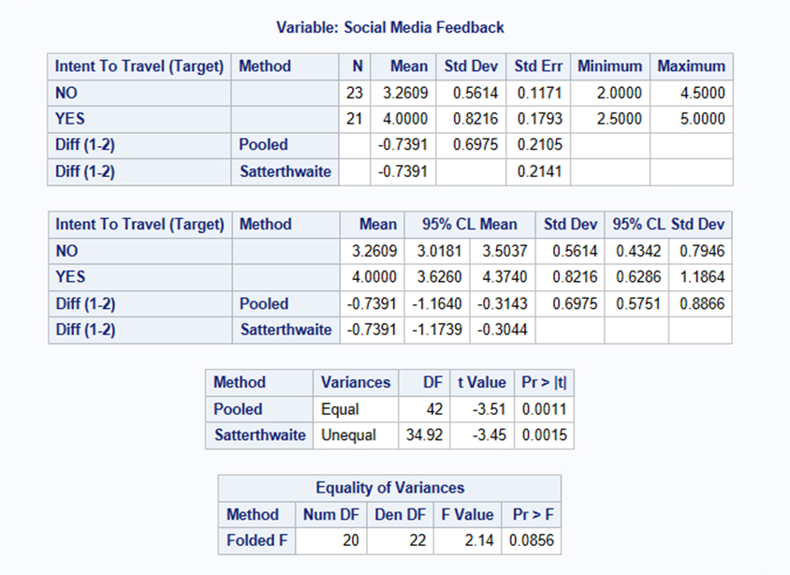
Hypothesis
T-Test
H0: Social media feedback does not significantly affect the intent to travel.
H1 : Social media feedback significantly affects the intent to travel.
Insight:
There is a statistically significant difference in "Intent to Travel" based on "Social Media Feedback." Respondents who received positive feedback (YES) have a significantly higher mean intent to travel (4.0000) compared to those who did not (NO 3.2609). The mean difference of -0.7391 is substantial and meaningful, suggesting that social media feedback strongly influences travel decisions.
Decision:
Since the analysis reveals a significant relationship, accept the hypothesis that "Social Media Feedback" significantly affects "Intent to Travel."

Slide 41
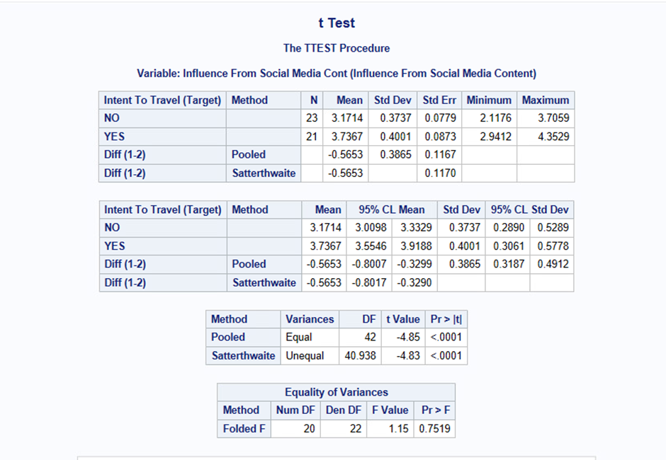
Hypotheses
H0: Influence from social media content does not significantly affect the intent to travel.
H1: Influence from social media content significantly affects the intent to travel.

Slide 42
INSIGHT
There is a statistically significant difference in "Intent to Travel" between individuals influenced by social media content and those who are not. Respondents in the "YES" group (Mean: 3.7367) have a significantly higher intent to travel compared to the "NO" group (Mean: 3.1714). The mean difference of -0.5653 is substantial and meaningful, indicating that influence from social media content strongly impacts travel decisions.
Decision:
Since the analysis reveals a significant relationship, accept the hypothesis that "Influence From Social Media Content" significantly affects "Intent to Travel."

Slide 43
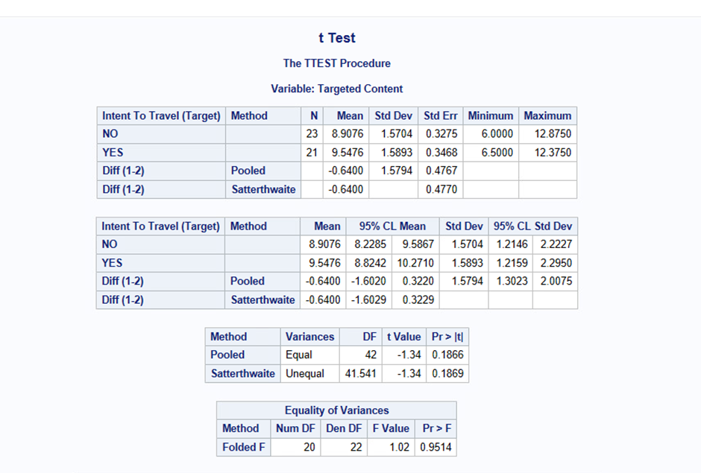
Hypotheses
H0 : Targeted content does not significantly affect the intent to travel.
H1 : Targeted content significantly affects the intent to travel.
Insight:
The p-value (0.1866) suggests that there is no statistically significant difference in "Intent to Travel" between those exposed to targeted content and those who are not.
Decision:
Since the p-value is greater than 0.05, fail to reject the null hypothesis. There is no significant relationship between exposure to targeted content and intent to travel.

Slide 44
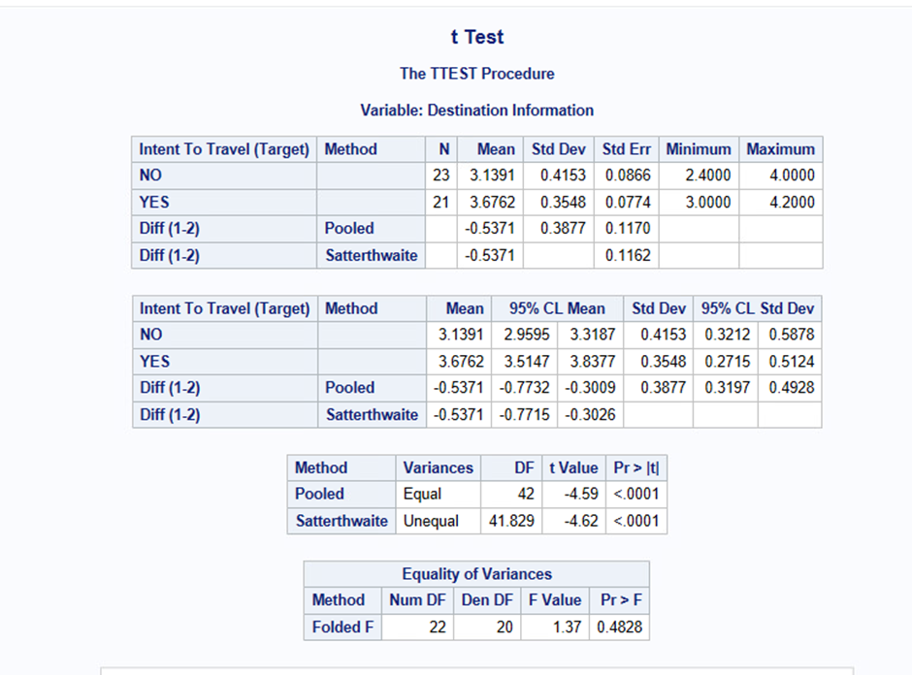
H0 : There is no difference in destination information perception between those with and without the intent to travel.
H1 : There is a significant difference in destination information perception between those with and without the intent to travel.

Slide 45
INSIGHT
There is a statistically significant difference in "Intent to Travel" between individuals with and without access to destination information. Respondents with access to destination information (YES) have a significantly higher intent to travel (Mean: 3.6762) compared to those without (NO Mean: 3.1391). The mean difference of -0.5371 highlights the importance of destination information in influencing travel intent.
Decision:
Since the analysis reveals a significant relationship, accept the hypothesis that "Destination Information" significantly affects "Intent to Travel."

Slide 47
Machine learning and Predictive Analysis

Slide 48
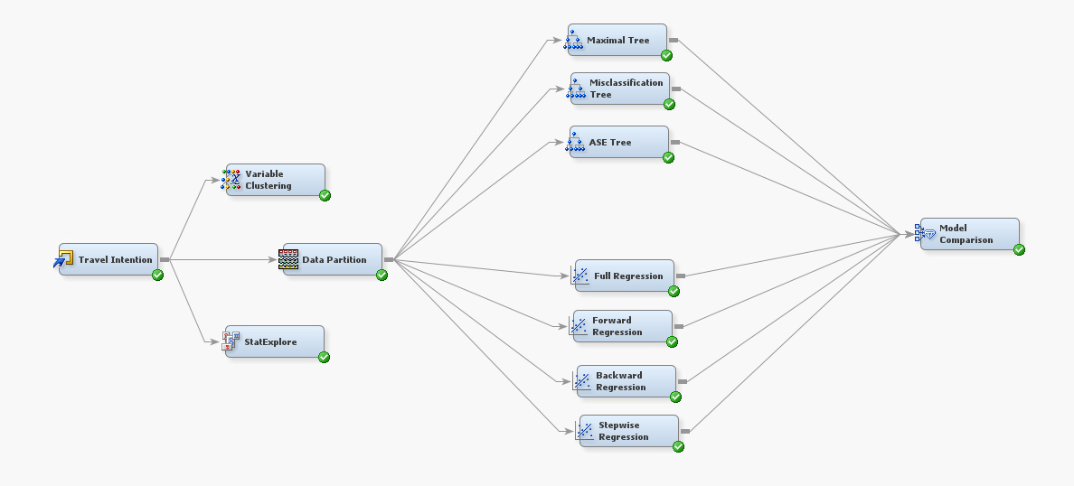
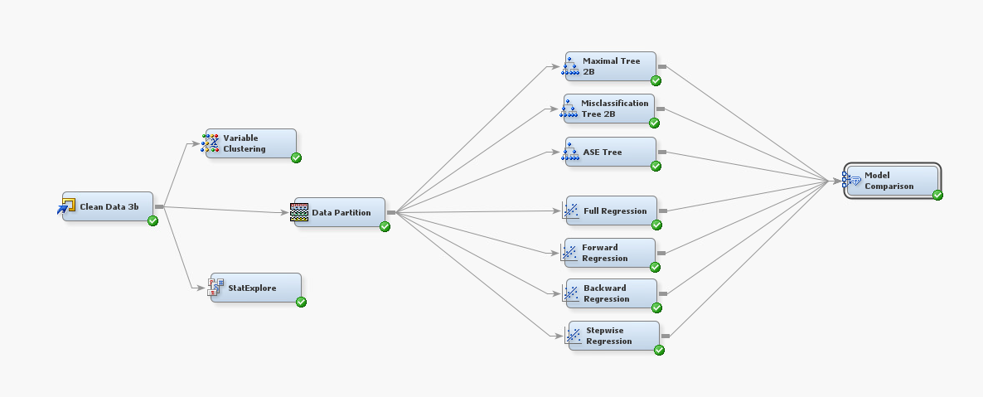
Process Flow Chart
Model 1: Binary Target
Model 2: Continuous Target

Slide 49
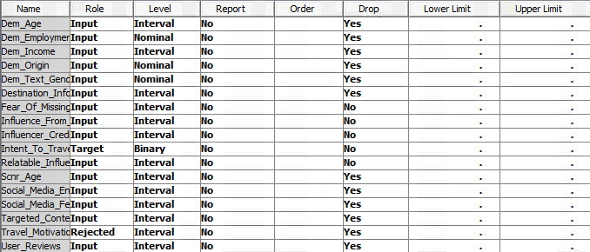
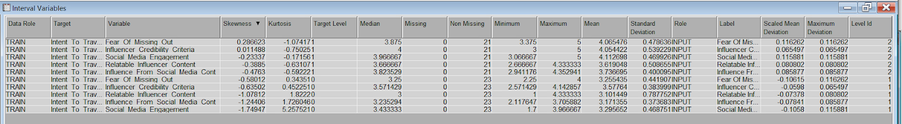
Variables story- Binary
Millennials are aspirational and experience-driven, heavily influenced by emotional triggers and peer validation. They value unique, shareable experiences and are more likely to act on travel decisions inspired by relatable content and credible social proof. To effectively target them, campaigns should focus on authentic storytelling, influencer partnerships, and leveraging social media platforms for visually engaging and relatable content.
Millennials are influenced by FOMO, social proof, and social media. Younger millennials prefer budget trips; older ones favor luxury. Use relatable influencers and reviews to build trust.

Slide 50
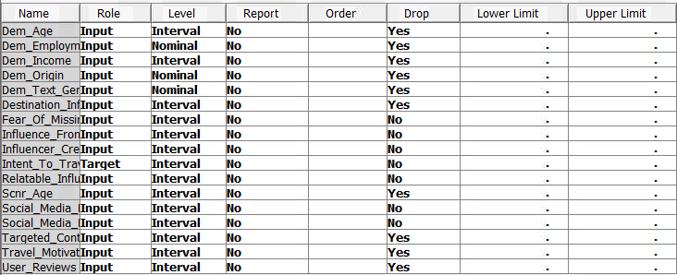
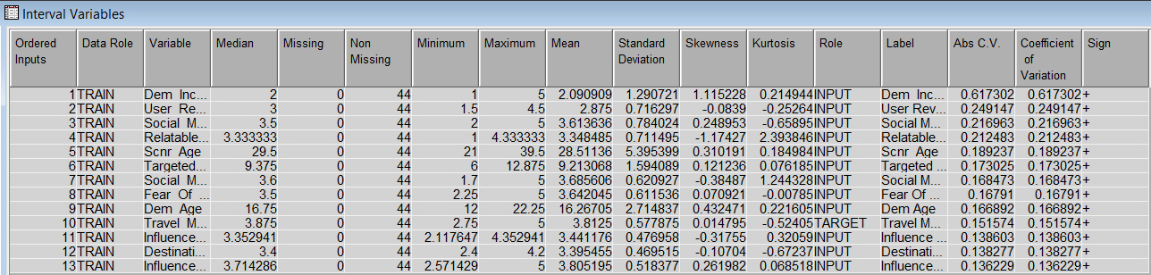
Variables story- Continuous
Millennials’ travel intent is driven by social media engagement, FOMO, and peer validation, supported by factors like age, income, and employment status. Emotionally driven and social media-savvy, they respond well to targeted campaigns tailored to their preferences, driving engagement and travel intent.

Slide 51
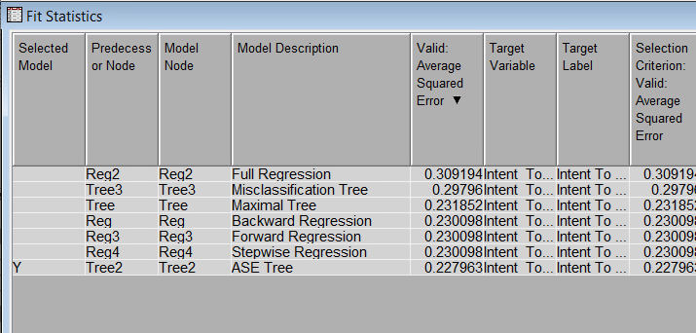
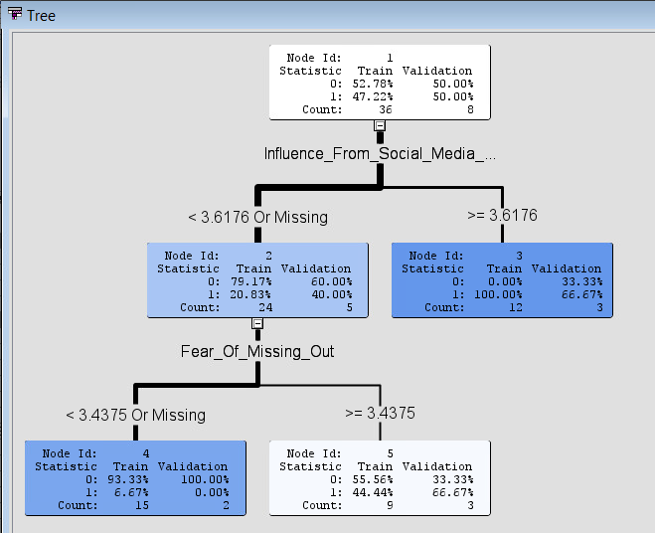
Model Comparison (Binary Model)
This analysis focuses on identifying the most predictive model for millennial travel intent, using various regression and decision tree techniques. The ASE (Average Squared Error) Tree emerges as the best-performing model, minimizing the error in validation data while identifying critical predictors like Influence From Social Media Content and Fear of Missing Out (FOMO). Nodes split based on social media impact and fear of missing out (FOMO), revealing how deeply these factors affect choices. Higher FOMO levels correlate with a greater response to social media, impacting decisions profoundly.
ASE Tree

Slide 52
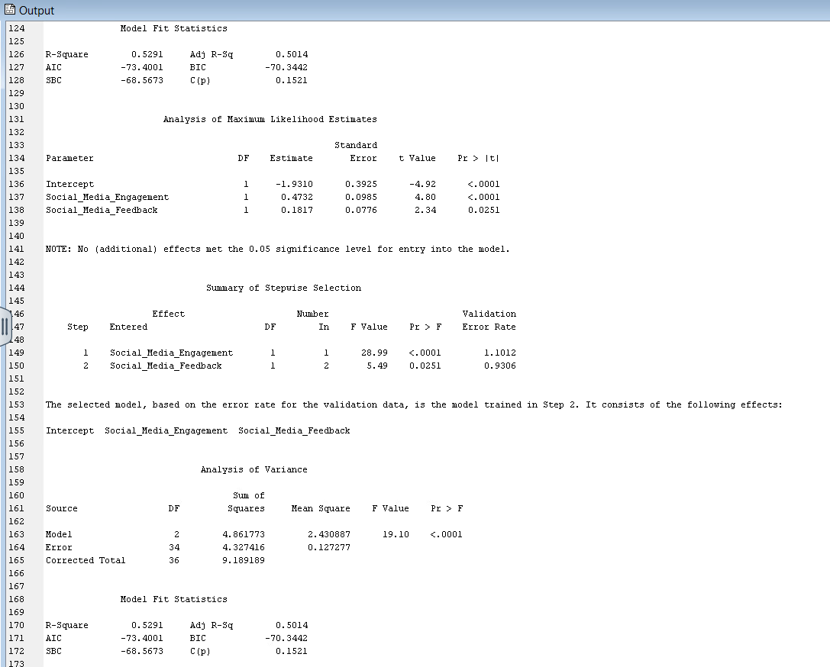
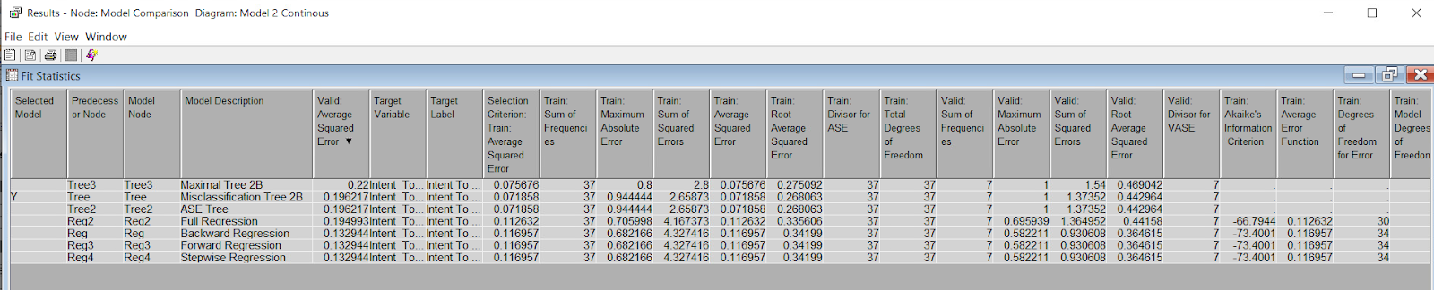
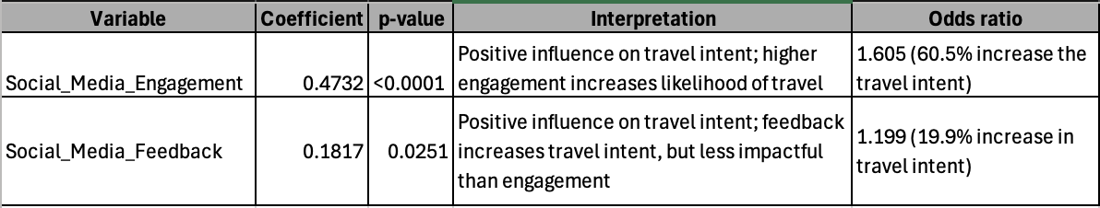
Model Comparison (Continuous Model)
R-Square: 0.5291
Adjusted R-Square: 0.5014
This analysis compares several regression and tree-based models to determine the best predictor of millennial travel intent, measured by their responses to various social, demographic, and psychological factors. Among the models, the ASE Tree and Stepwise Regression emerge as top-performing methods, with the ASE Tree slightly outperforming others in terms of predictive accuracy.
Stepwise Regression

Slide 53
Recommendation
Recommendation
Partner with Relatable and Credible Influencers
Why: Influencer credibility strongly influences travel intent. Respondents who trust influencers showed significantly higher travel intent scores.
Actionable Steps:
Collaborate with micro-influencers who align with the values of Millennials and Gen Z, such as sustainability, adventure, or luxury.
Encourage influencers to share authentic, detailed travel stories rather than purely promotional content.
Incorporate user-generated content and influencer reviews in campaigns to build trust and relatability.

Slide 54
Recommendation
Leverage FOMO (Fear of Missing Out) Through Exclusive and Time-Sensitive Campaigns
Why: FOMO was found to have a strong positive correlation (r=0.77) with travel intent, making it a significant motivator for this demographic.
Actionable Steps:
Create campaigns emphasizing limited-time offers, exclusive destinations, or experiences ("Book now, only 2 spots left!").
Highlight unique, rare, or trending travel experiences through visually engaging social media ads.
Use hashtags like #OnceInALifetime or #DontMissOut to amplify urgency.

Slide 55
References
Ghaly, M. (2023). The influence of user-generated content and social media travel influencers credibility on the visit intention of Generation Z. Journal of Association of Arab Universities for Tourism and Hospitality, 24(2), 367–382. https://doi.org/10.21608/jaauth.2023.218047.1477Machado, D., Santos, P., & Medeiros, M. (2021).
Effects of Social Comparison, Travel Envy and Self- presentation on the Intention to Visit Tourist Destinations. Brazilian Business Review, 18(3), 297–316. https://doi.org/10.15728/bbr.2021.18.3.4Rahjasa, S. L., Prasasti, G., & Apriliani, K. M. (2024).
How Travel Influencer and Social Media Influence Tourist Travel Decision to Ubud. TRJ Tourism Research Journal, 8(1), 127. https://doi.org/10.30647/trj.v8i1.243Sharma, R., Singh, G., & Pratt, S. (2022).
Exploring travel envy and social return in domestic travel: A cross- generational analysis. Journal of Travel & Tourism Marketing, 39(1), 58–72. https://doi.org/10.1080/10548408.2022.2045247

Slide 56
Thank you

